Slide 1
Special Education
Pedagogy, Inclusion, Accommodation, Adaptation, Modification

Slide 2
Teaching is a calling, teaching Special Education is a passion.
If you do not have a passion in your heart for helping others achieve success, you should not be here.

Slide 3
Practical Divisions for Martial Arts Schools
Medically Fragile: Physical concerns, Safety concerns
Autistic Spectrum Disorders
Cognitive Delays and Disabilities
Physical Delays and Disabilities
Emotional Disturbance

Slide 4
Pedagogy
pedagogy (n): the art and science of teaching

Slide 5
Teaching is Equal Parts
Science
Know the facts
Know your goals
Have strategies in place
Implement and maintain strategies
Measure and Document EVERYTHING!
Art
Focus on the individual student
Be willing to change on the fly
Leave room for improvisation
Be willing to trust your gut
Your students are HUMAN, not a machine to be reduced to statistics!

Slide 6
The Science
Special Education pedagogy (as pertains to Martial Arts schools) is based primarily upon 7 things:
Hierarchy of needs
Learning modalities
Inclusion
Adaptations
Accommodations
Modifications
Behavior Modification
I can teach you the foundation of Special education pedagogy.
You will have to create your own art through practice, repetition, experience, and trial and error(sound familiar – a little like Martial Arts?).

Slide 7
Maslow’s Hierarchy of Needs

Slide 8
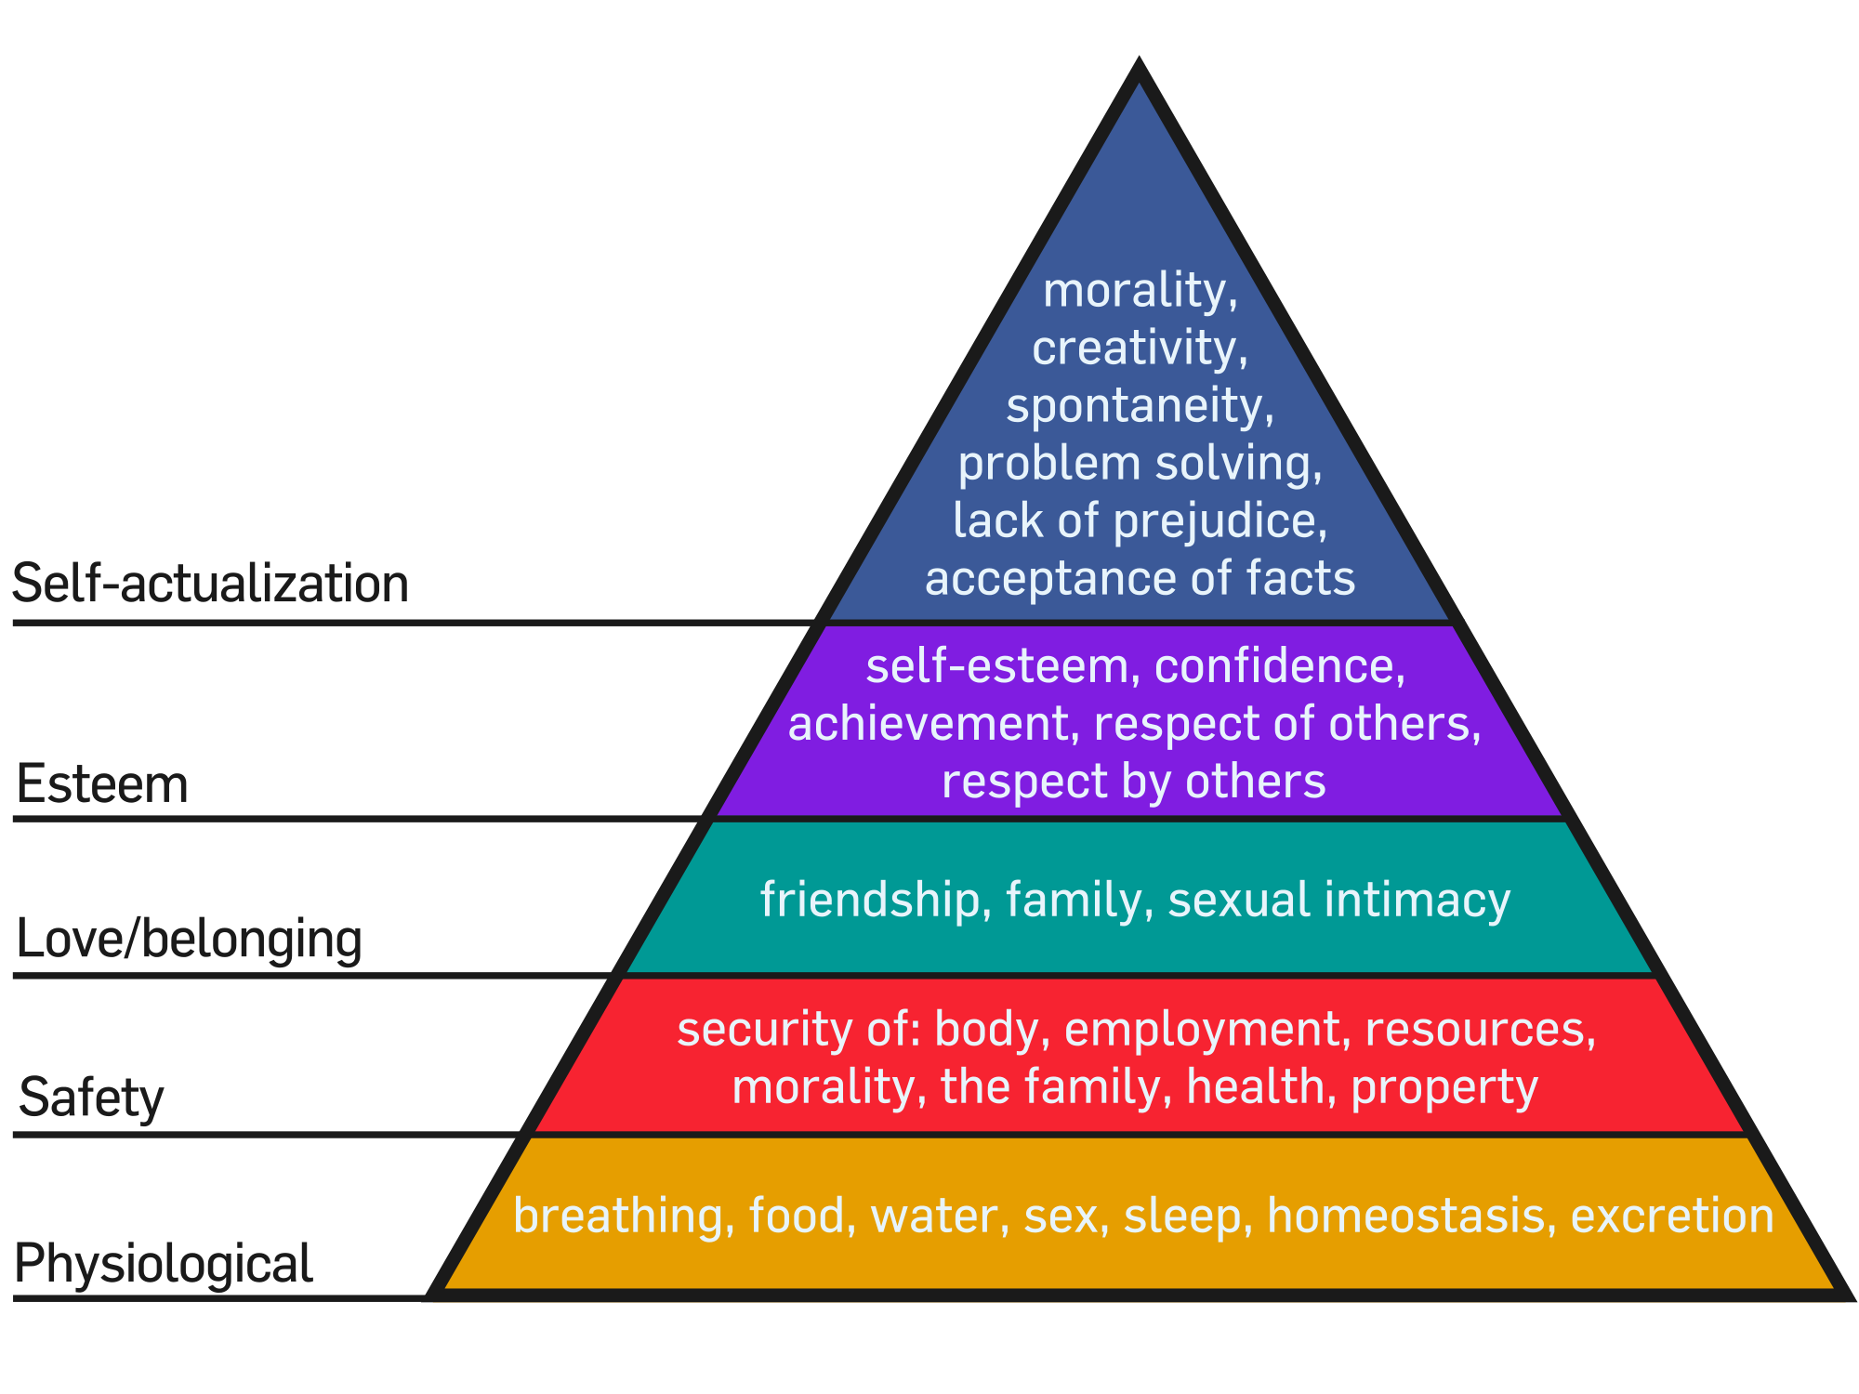
Needs and Education
Maslow's hierarchy of needs theory has made a major contribution to teaching and classroom management in schools. Rather than reducing behavior to a response in the environment, Maslow adopts a holistic approach to education and learning. Maslow looks at the entire physical, emotional, social, and intellectual qualities of an individual and how they impact on learning.
Applications of Maslow's hierarchy theory to the work of the classroom teacher are obvious. Before a student's cognitive needs can be met they must first fulfil their basic physiological needs. For example a tired and hungry student will find it difficult to focus on learning. Students need to feel emotionally and physically safe and accepted within the classroom to progress and reach their full potential.
Maslow suggests students must be shown that they are valued and respected in the classroom and the teacher should create a supportive environment. Students with a low self esteem will not progress academically at an optimum rate until their self-esteem is strengthened.
(http://www.simplypsychology.org/maslow.html)

Slide 9
Learning Modalities
4 learning modalities
Garner’s multiple intelligences

Slide 10
Four learning modalities
Visual – “learn by watching”
Auditory – “learn by listening”
Kinesthetic – “learn by moving and doing”
Tactile – “learn by touching”

Slide 11
Gardner’s Intelligences
Visual – Spatial: Think in terms of physical space
Bodily – Kinesthetic: Movement oriented
Musical: Sensitivity to music, rhythm, and sound
Intrapersonal: Understanding one’s own interests and goals
Interpersonal: Understanding interacting with others
Linguistic: Using words effectively
Logical – Mathematical: Reasoning and calculating

Slide 12
Comparison between them
4 Learning Modalities
Garner’s Multiple intelligences
Four primary ways of learning
Easily unified into lessons
Applicable to various disciplines
More concerned with facilitating actual learning
Seven primary ways of learning
Tend to be modality specific
Some modalities are of limited application
More focused on how the individual learns

Slide 13
In Martial Arts, the 4 modalities work best
Martial arts are a kinesthetic, tactile pursuit. Instruction commonly uses verbal instruction paired with visual demonstration.
In short, we already use an integrated model of 4 learning modalities every day!

Slide 14
Inclusion
Inclusion (N) the action or state of including or of being included within a group or structure.

Slide 15
Inclusion in Education
The goal of inclusion in Special Education is to have every student of every ability in the same age appropriate classroom, receiving instruction together.
It is a hotly debated concept, that meets with much resistance.
There are two main models of inclusion: “Push In”, and “Full Inclusion”

Slide 16
“Push In” inclusion
"Push In" has the special education teacher enter the classroom to provide instruction and support to children. The push in teacher will bring materials into the classroom. The teacher may work with the child on math during the math period, or perhaps reading during the literacy block. The push in teacher also often provides instructional support to the general education teacher, perhaps helping with differentiation of instruction.
http://specialed.about.com/od/integration/a/Inclusion-What-Is-Inclusion.htm

Slide 17
“Full Inclusion”
"Full Inclusion" places a special education teacher as a full partner in a classroom with a general education teacher. The general education teacher is the teacher of record, and is responsible for the child, even though the child may have an IEP. There are strategies to help children with IEPs succeed, but there are also many challenges. No doubt not all teachers are well suited to partner in full inclusion, but skills for collaboration can be learned.
http://specialed.about.com/od/integration/a/Inclusion-What-Is-Inclusion.htm

Slide 18
The reality of forced inclusion
Desired outcome
Realistic outcome
Develop individual strengths and gifts, with high and appropriate expectations for each child.
Work on individual goals while participating in the life of the classroom with other students their own age.
Involve their parents in their education and in the activities of their local schools.
Foster a school culture of respect and belonging. Inclusive education provides opportunities to learn about and accept individual differences, lessening the impact of harassment and bullying.
Develop friendships with a wide variety of other children, each with their own individual needs and abilities.
Positively affect both their school and community to appreciate diversity and inclusion on a broader level.
Lack of proper education for the instructors results in substandard instruction due to disruptions, delays, and distractions
Some significant success has been seen on individual goals while participating in the life of the classroom with other students their own age.
Parental involvement remains similar to traditional classes in their education and in the activities of their local schools.
It depends ENTIRELY on the staff of a school to foster a school culture of respect and belonging. Inclusive education provides opportunities to learn about and accept individual differences, lessening the impact of harassment and bullying, but only if the teachers make sure to teach it.
friendships with a wide variety of other children, each with their own individual needs and abilities does occur, but many “Abled” students grow to resent the time and effort spent on the special needs population.
Overwhelmingly, the school and community learn to appreciate diversity on a broader level, but inclusion has become an educational battleground with parents and educators falling on both sides of the debate.

Slide 19
Inclusion for Martial Arts?
If you wish to teach students with special needs, you MUST embrace the concept of “Limited, appropriate, inclusion”. There is no other way.

Slide 20
But Wait…What on EARTH is “Limited, appropriate, Inclusion?!?!
Student
Mainstream class
Specialized class
Combination of the three?
Private lessons
It’s a process of classifying your student by what classes are best FOR THEM.
A student will go to a combination of classes you offer based upon where they will see the most success.
This schedule will be determined by your initial assessment of the student during their first lesson.

Slide 21
Sample Inclusion Plan – 1.
Private lessons
We never turn down private lessons, but this student doesn’t NEED them.
Specialized class
You should have a once a week class for Asperger students if your schedule allows. This class would be based on social skill building and slower paced instruction designed to build balance, core strength, and motor issues common to Aspies.
Mainstream class
This student ABSOLUTELY NEEDS to be in your mainstream class. Aspies can look forward to an exceptionally fulfilling life - IF they can learn to work with and interact with society.
Student has mild Asperger Syndrome.
Student is socially awkward, sarcastic, and tends to insult people inadvertently.
The student is extremely smart.
The student has a mild motor impairment that exhibits as poor balance and extreme difficulty crossing the centerline of the body

Slide 22
Sample Inclusion plan - 2
Private lessons
Private lessons are a priority for such a student. 1 lesson a week where you, the parent, and the student can work together to build a routine and pattern of training
Specialized class
You offer a once a week class dedicated to students with mild / moderate autism and cognitive delays. The class is game based, and builds social skills as much as karate
Mainstream class
This student should not enter the mainstream class until and if they reach a point that they can participate on their own
The student is classified as a moderate Autistic child.
The student is 12 years old, semi-verbal, and needs physical direction from the teacher or he just tends to stand there.
Core strength and muscle tone are very low.

Slide 23
Sample Inclusion Plan – 3.
Private lessons
What
Specialized Class
Would
Mainstreamed class
You do?
You have a 9 year old student with Cerebral Palsy.
The student is cognitively normal.
The student is a spastic quad, and typically moves in a wheel chair, but he can use a walker for extremely limited amounts of time.

Slide 24
Sample Inclusion Plan – 3.
Private lessons
Again – never turn down private lessons, but it’s really not appropriate for a student with CP
Specialized Class
You MUST offer a class for students with profound physical disabilities ! This class will be all for them – their special workout.
Mainstreamed class
Definitely! A student at this age and this severity will never be able to do what others take for granted, but you can modify the lessons for them and have them work techniques taught in the specialized class right alongside the physically abled students!
You have a 9 year old student with Cerebral Palsy.
The student is a spastic quad, and typically moves in a wheel chair, but he can use a walker for extremely limited amounts of time.

Slide 25
Adaptations
Adaptation: A documented process that allows a student with special educational needs to participate in the prescribed provincial curriculum with changes in format, instructional strategies and/or assessment procedures that retain the learning outcomes of the curriculum.

Slide 26
Adaptations for Martial arts
Adaptations are used to create opportunities for students to learn THE ACTUAL, COMPLETE skill sets taught at your school to everyone.

Slide 27
Common Adaptations in Martial arts
Teach single movements instead of complete movement.
Teach footwork / stepping separate from upper body
Work single motion
Develop drills to build foundations before instruction
Activities to build strength for other skills.
Ultimately, Adaptation of the lesson involves you changing what and how you are teaching to the student in order to build a foundation of learning later.

Slide 28
Accommodations
Accommodations : supports and services provided to help a student access the general education curriculum and validly demonstrate learning.

Slide 29
Accommodations for Martial Arts
Accommodations in Martial arts schools are physical changes made to your school space to make learning easier and possible for all students

Slide 30
Common Accommodations in Martial arts
Wide pathways for Wheel chairs
Pathways clear of tripping hazards for students with walkers / crutches
Seats / benches for students to sit on while training upper body
Color coded striking pads
Taped lines on the ground for movement
Smaller, lighter equipment than common
Most accommodations in the Martial arts school will involve making room for students with assistive devices, changing around equipment to better engage the students interest, and possibly even creating new equipment on your own.

Slide 31
Modifications
Modifications: Individualized changes made to the content and performance expectations for students.

Slide 32
Modifications in the Martial Arts
Modifications will be essential to students with Severe disabilities. It involves substantially changing your curriculum and creating separate standards for the individual.

Slide 33
Common Modifications in the Martial Arts
Requiring front kicks from a wheel chair, but not other kicks.
Exempting from sparing due to medical concerns
Using crutches as extensions of the arms
Developing seated forms / katas
Using modified weapons and techniques
Modifications are both obvious acknowledgements of student disabilities, and development of structured, measurable NEW goals for the student to reach in order for promotion.
It is NOT permission to give belts away!

Slide 34
Remember:
Adaptations, Accommodations, and Modifications are in place to MAXIMISE the students potential.
That can’t happen if you have pre-conceived notions about their abilities. TRUST the initial evaluation / assessment you do in the first class, but always be pushing the student to succeed.
“When we make assumptions about what people can’t do, we don’t give them a chance to show what they can”.

Slide 35
Behavioral Intervention
Behavioral Intervention: systematically applying principles of learning theory to improve socially significant behaviors to a meaningful degree, and to demonstrate that the interventions employed are responsible for the improvement of behavior.

Slide 36
Behavioral interventions in Martial Arts
Martial Arts is perfectly structured to build positive social behaviors.
It’s practically what we do!

Slide 37
Common Behavioral Interventions in Martial Arts
Respect
Honor
Duty
Confidence
Self Esteem
Focus
Discipline
Most behavior interventions come from our focus on the core concepts of living the Martial Way.

Slide 38
Discipline in the School
We MUST modernize our system of developing appropriate behaviors from our students!

Slide 39
Students should not fear their instructors – EVER.
Create a bond with your students. Create a safe environment where they can both be themselves and learn to be a better version of themselves at the same time.

Slide 40
Behavioral Therapy Concepts
Create a routine. Try to follow the same schedule every day, from wake-up time to bedtime.
Get organized. Put equipment, and weapons in the same place every day so your student will be less likely to lose them.
Avoid distractions. Turn off the TV, radio, and avoid noisy, busy environments.
Limit choices. Offer a choice between two things (this drill, form, kick etc., or that one) so that your student isn't overwhelmed and overstimulated.
Change your interactions with your student. Instead of long-winded explanations and cajoling, use clear, brief directions to remind your student of responsibilities.
Use goals and rewards. Use a chart to list goals and track positive behaviors, then reward your student's efforts. Be sure the goals are realistic—baby steps are important!
Discipline effectively. Instead of yelling or push-ups, use timeouts or removal of privileges as consequences for inappropriate behavior.
Help your student discover a talent. All kids need to experience success to feel good about themselves. Finding out what your student does well can boost social skills and self-esteem.

Slide 41
Students should WANT to go to your school!
Create a clear understanding of your policy with parents BEFORE any issues arise.
Provide options and choices for the student.
Explain the consequences of each option (good and bad).
Allow them with the choice.
Enforce the consequences fairly and evenly.
EVERY DAY IS A NEW DAY. DON’T DWELL!
The worst thing your students should be able to imagine is not being allowed to participate in your classes for the day

